Slide 1
SOFTWARE PROJECT SEMESTER-8
YouTube Trending Videos
PREPARD BY:
Krunal Bhanderi– 165220686004
Yash Dhameliya - 165220686009
INTARNAL GUIDE
Dr. Sunil Bajeja

Slide 2
ACKNOWLEDGEMENT
It is indeed a great pleasure to express our thanks and gratitude to all those who helped us. No serious and lasting achievement or success one can ever achieve without the help of friendly guidance and co-operation of so many people involved in the work.
We are very thankful to our guide Dr. Sunil Bajeja, the person who makes us to follow the right steps during a project work. We express our deep sense of gratitude to for her guidance, suggestions and expertise at every stage. A part from that her valuable and expertise suggestion during documentation of our report indeed help us a lot.

Slide 3
ACKNOWLEDGEMENT
Thanks to our friend and colleague who have been a source of inspiration and motivation that helped to us during our project work.
We would heartily thankful to Head and Dean of our department Dr. Sunil Bajeja and Dr. R. Sridaran to give me an opportunity to work over this report and for their end-less and great support. And to all other people who directly or indirectly supported and help me to fulfil our task.

Slide 4
INTRODUCTION
YouTube (the world-famous video sharing website) maintains a list of the top trending video on the platform. According to Variety magazine, “To determine the year’s top-trending videos, YouTube uses a combination of factors including measuring users’ interactions (number of views, comments and likes). Note that they’re not the most-viewed videos overall for the calendar year”.
This dataset is a daily record of the top trending YouTube videos.
Data includes the video id, video title, channel title, publish time, tags, views, likes and dislikes, thumbnail, comment disable, rating disable, video error or removed, description, and comment count.

Slide 5
PROBLEM STATEMENT
What is relation between video likes, dislike and ranking?
What is relation between comment count and ranking?
What is relation between video view and ranking?
Do tags of video affect the video ranking?
Effects of video publish time on video ranking.
Percentage of videos that being deleted or face some error.
Percentage of videos that comment and ratings were disable.

Slide 6
ORGANIZATION OF DATA
This dataset contains information of athlete events from 1998 to 2016, Which amounts to 12826 athlete events total. It contains 12826 observation of 14 variables, which
This database contain information of trending videos on YouTube. It contain 40,000 observation on 15 different values which include the video id, video title, channel title, publish time, tags, views, likes and dislikes, thumbnail, comment disable, rating disable, video error or removed, description, and comment count.
video_id:
This field contains unique video id.
trending_date:
This field contains the date on which date specific video was in trending.
Title:
This field contains the video title.

Slide 7
ORGANIZATION OF DATA
channel_title:
This field contains the channel name related to video.
publish_time:
This field contains the date of publish including time.
Tags:
This field contains the video tags that helps to search related videos.
Views:
This field contains total number of views of videos.
Likes:
This field contains total number of likes given to video.

Slide 8
ORGANIZATION OF DATA
Dislikes:
This field contains total number of dislikes given to video.
comment_count:
This field contains total count of comments given to the video.
thumbnail_link:
This field contains the link of cover image of video uploaded on YouTube.
comments_disabled:
It shows the comment section is enabled or disabled.

Slide 9
ORGANIZATION OF DATA
ratings_disabled:
It shows the ratings are enabled or disabled for paid content.
video_error_or_removed:
It shows the video status for check the video exists or not and also check whether the video has some errors or not.
Description:
This field shows the description of video.
Category_id:
Specify the category of video like Music, Movies, Sports etc.

Slide 10
DATA VISUALISATION THROUGH SUMMARY
How did I obtain the data set?
I got the dataset from kaggle website. It contain information about trending videos on YouTube.
How the data originally collected?
Data is collected from YouTube website that maintains the record of all trending videos on YouTube.

Slide 11
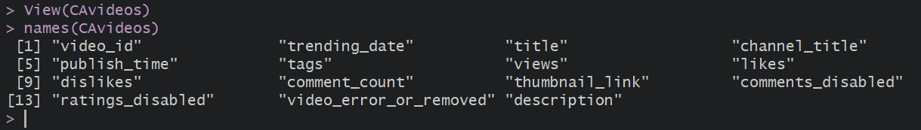
DATA VISUALISATION THROUGH SUMMARY
How many rows and columns are in the dataset?
There are 40882 rows and 15 columns.
What are the columns in dataset?

Slide 12
METHODS / TECHNIQUES
Identification of techniques and tool used
R is a programming language and software environment for statistical analysis, graphics representation and reporting R was created by Ross Ihaka and Robert Gentleman at the University of Auckland, and is currently development by the R Development Core Team. R is freely available under the GNU General Public License, and per-compiled binary version are provided for various operating systems like Linux, Windows and Mac. This programming language was named R, based on the first letter of first name of the two R authors (Robert Gentleman and Ross Ihaka), and partly a play on the name of the Bell Labs Language S.
As stated earlier, R is a programming language and software environment for statistical analysis, graphics representation and reporting. The following are the important features of R -

Slide 13
METHODS / TECHNIQUES
R is a well-developed, simple and effective programming language which includes condition, loops, user defined recursive functions and input and output facilities.
R has an effective data handling and storage facility.
R provides a suite of operators for calculations on array, lists, vectors and matrices.
R provides a large, coherent and integrated collection of tools for data analysis.

Slide 14
METHODS / TECHNIQUES
R provides graphical facilities for data analysis and display either directly at the computer or printing at the papers.
As a conclusion, R is world’s most widely used statistics programming language. It’s the #1 choice of data scientists and supported by a vibrant and talented community of contributors. R is taught in universities and deployed in mission critical business applications. This tutorial will teach you R programming along with suitable examples in simple and easy steps.

Slide 15
METHODS / TECHNIQUES
Application of techniques and tools used
R will provide numerical or graphical summaries of data
R has extensive graphical abilities
R will handle a variety of specific analyses : Correlation, Straight Line Regression

Slide 16
METHODS / TECHNIQUES
Assumption
According to the Research and Innovative Technology Administration Bureau of Sports Statistics, this athlete dataset includes information about every games that departed form New York City in 2016. Therefore, due to the size and amount of data collected here, we can make the assumption that this dataset exhibits randomization without any bias.

Slide 17
METHODS / TECHNIQUES
Randomize : What is the Randomization Scheme?
While our original assumption claimed that the entire sports dataset exhibits randomization, our analysis needed to ensure that we developed a completely randomization design. In meeting this objective, a new dataset is created(“athlete”) that randomly selects 12826 observations from “data_raw”. In creating this new dataset, we’re ensuring that our analysis considers a large sample of an even larger population and randomizes the order that the runs of the data are placed in the dataset (since they were originally listed chronologically by departure date.) After creating this new dataset, we can now assume that our randomization scheme represents a completely randomized design.

Slide 18
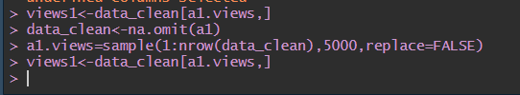

Slide 19
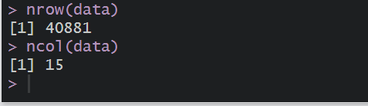
PRELIMINARY ANALYSIS
The number of rows and columns in the dataset :

Slide 20
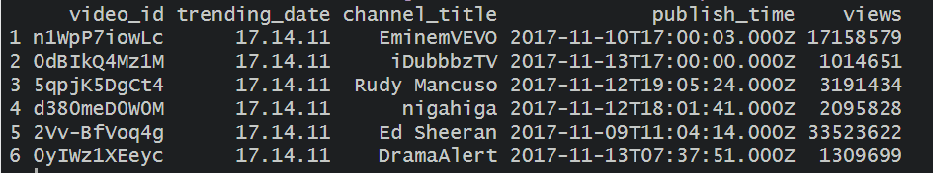
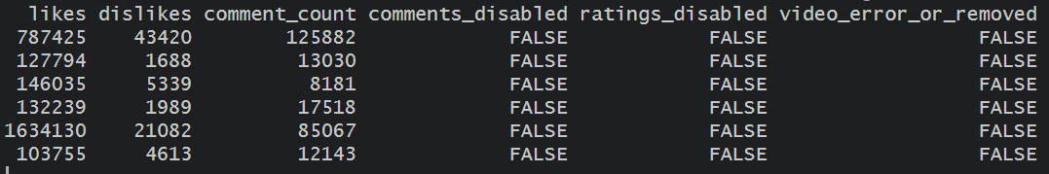
PRELIMINARY ANALYSIS
The first six values in the dataset :

Slide 21

PRELIMINARY ANALYSIS
Data Cleansing : omit NA cases using the na.omit function and record the “age” column using indexing and reassignment

Slide 22
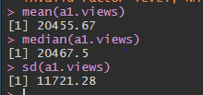
PRELIMINARY ANALYSIS
What was the mean, median and standard deviation of Age?

Slide 23
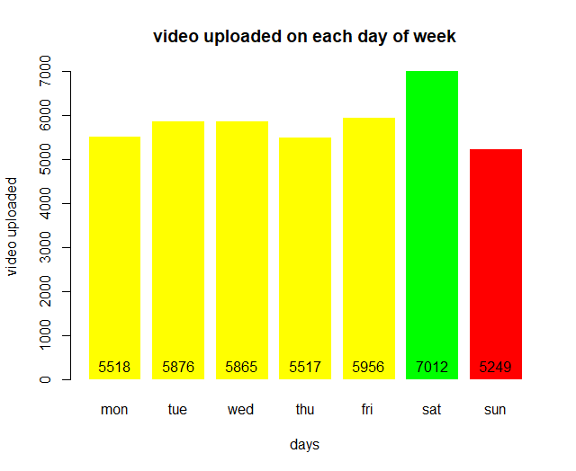
GRAPHICAL DESCRIPTION OF DATA

Slide 24
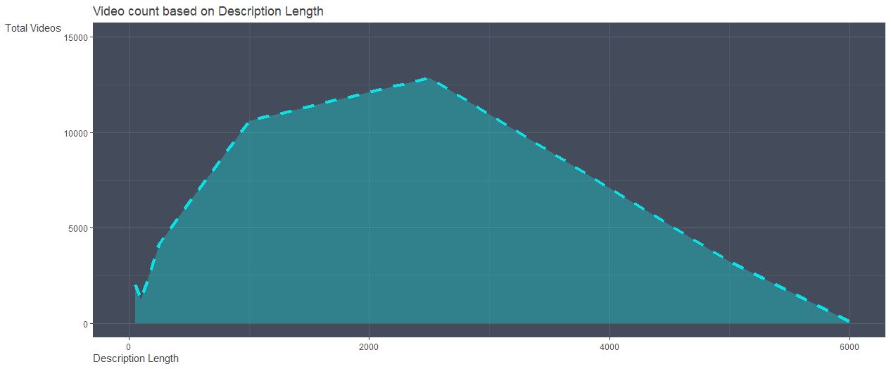
Area graph of video count based on description length

Slide 25
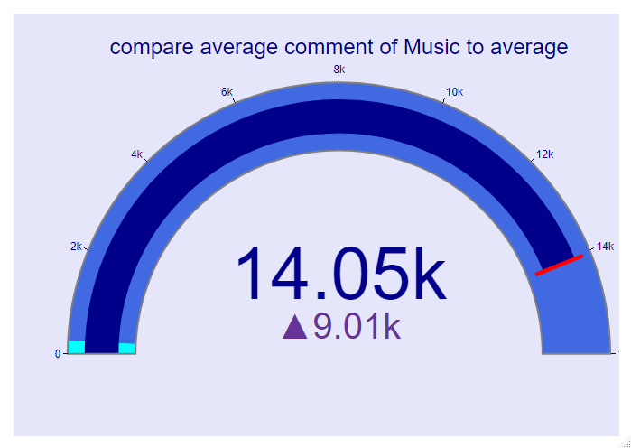
Guage chart comparing average comment of music to the average comment

Slide 26
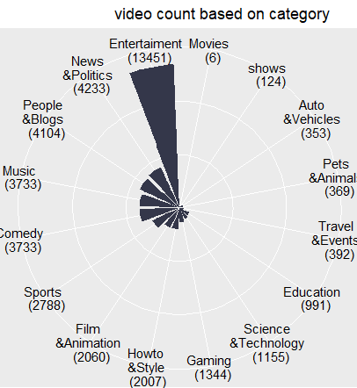
Bar Chart of video count based on category

Slide 27
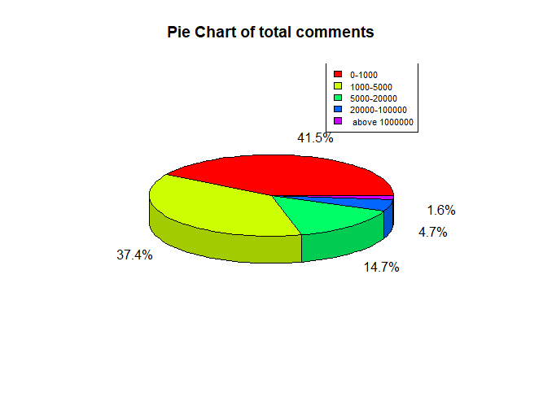
PieChart Of Comment Counts

Slide 28
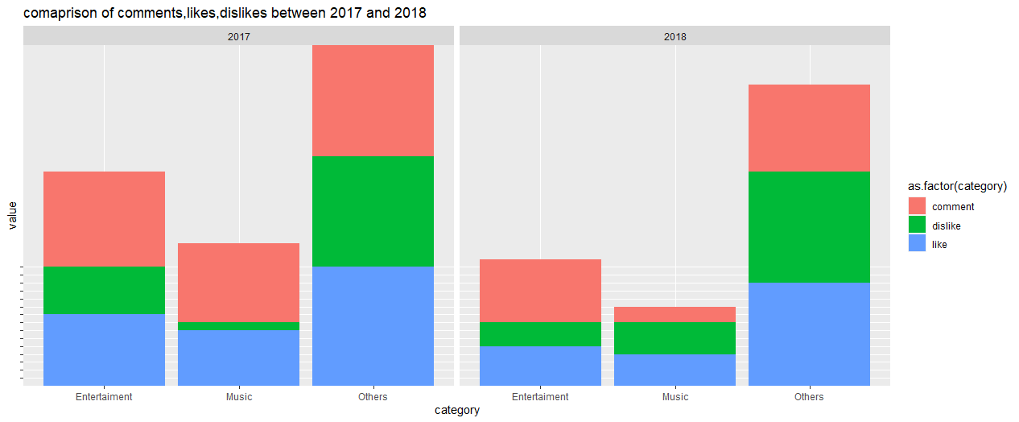
Bar Graph of comparing 2017 and 2018 like, dislike and comments

Slide 29
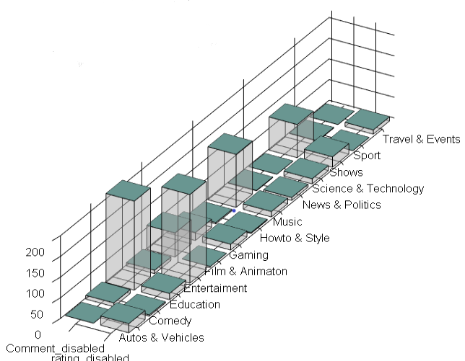
Bar Graph of Comment & Rating disabled

Slide 30
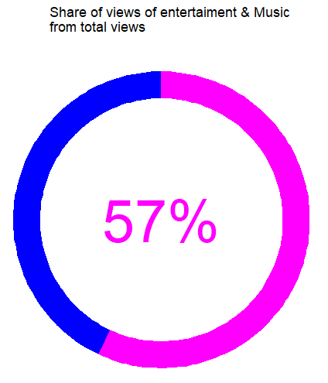
Donut Graph of share of views of Entertainment & Music from all views

Slide 31
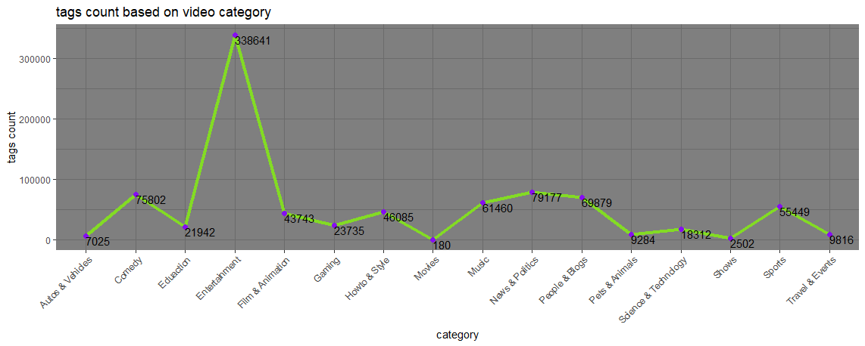
Line Graph of tags count based on video category

Slide 32
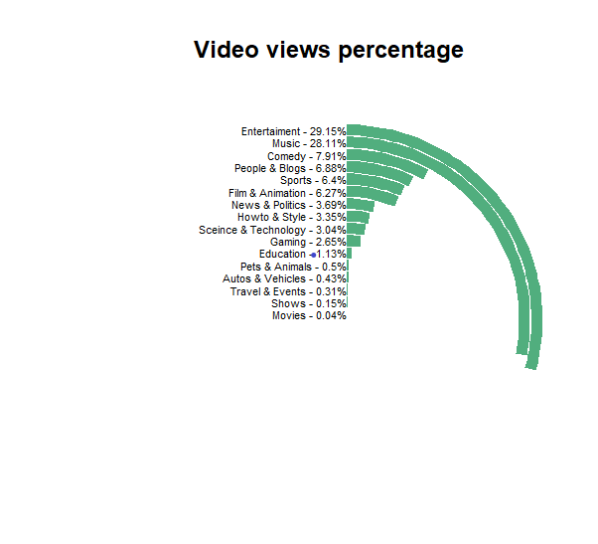
Bar Graph of video views percentage based on category

Slide 33
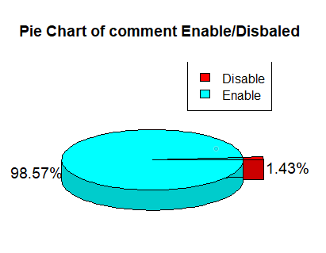
Pie chart of Comment Enable/Disable

Slide 34
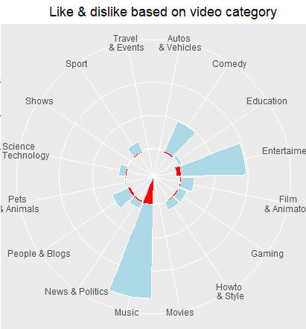
Bar Chart of Like & Dislike based on Category

Slide 35
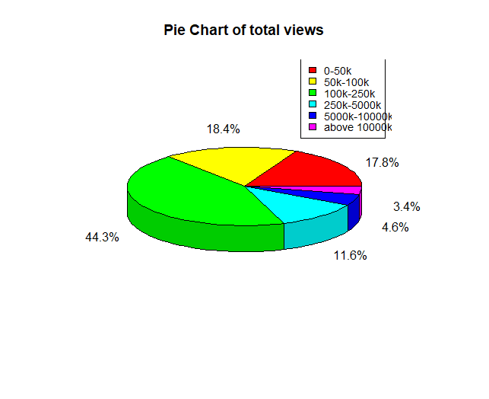
Pie Chat of total Views

Slide 36
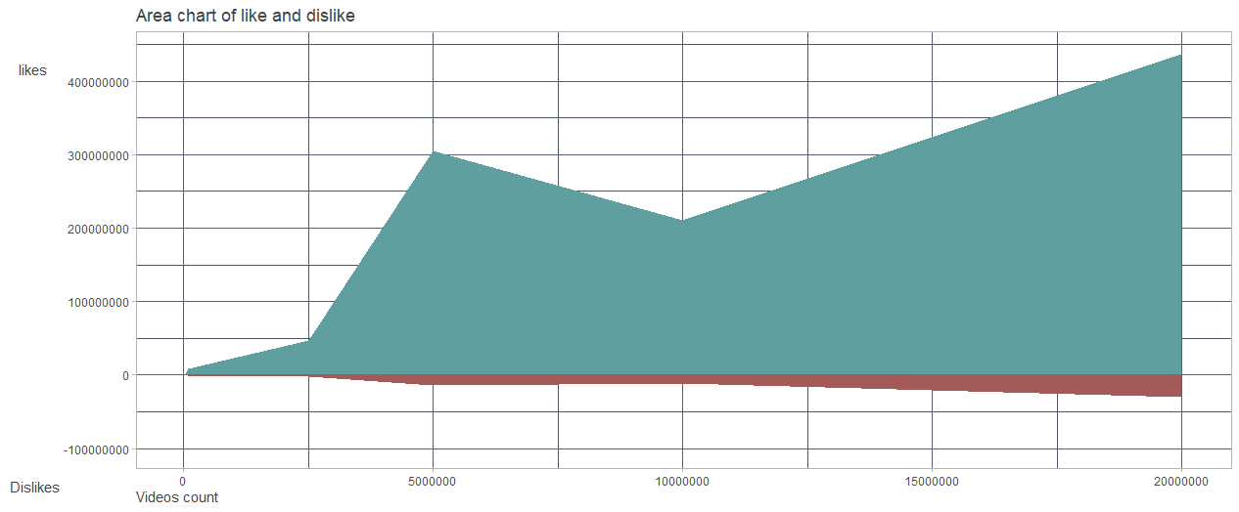
Area Graph like, dislike comparison

Slide 37
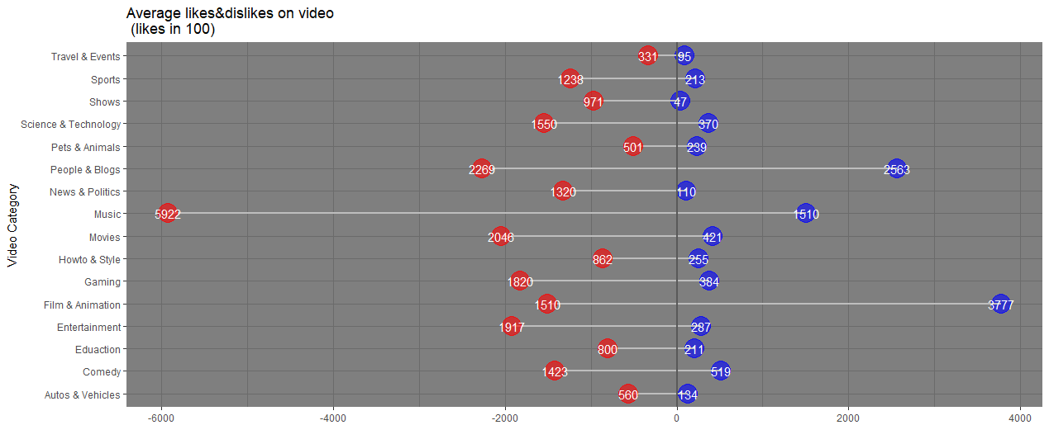
Lolipop Graph of average like and dislike based on catgory

Slide 38
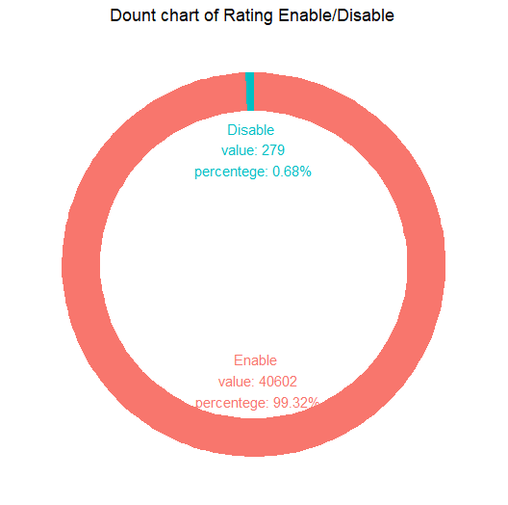
Donut Graph of Rating Enabled/Disables

Slide 39
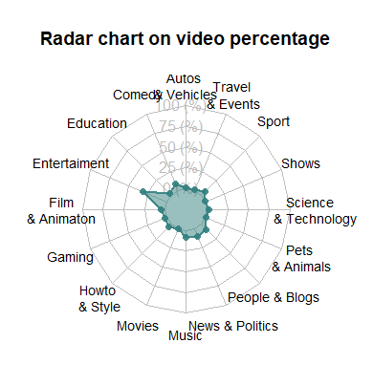
Radar Graph of video percentage based on category

Slide 40
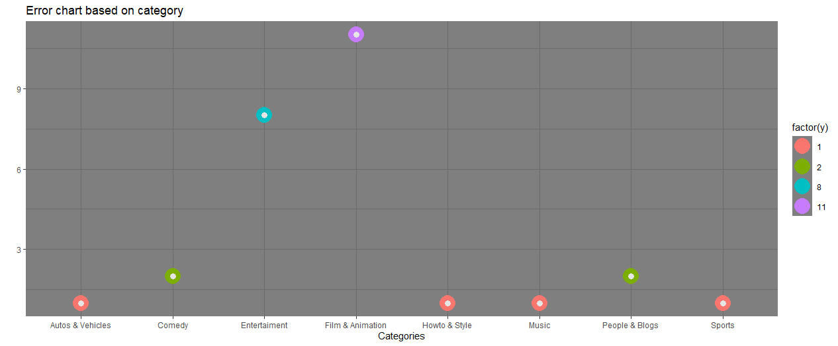
Dot Graph of video error or removed based on category

Slide 41
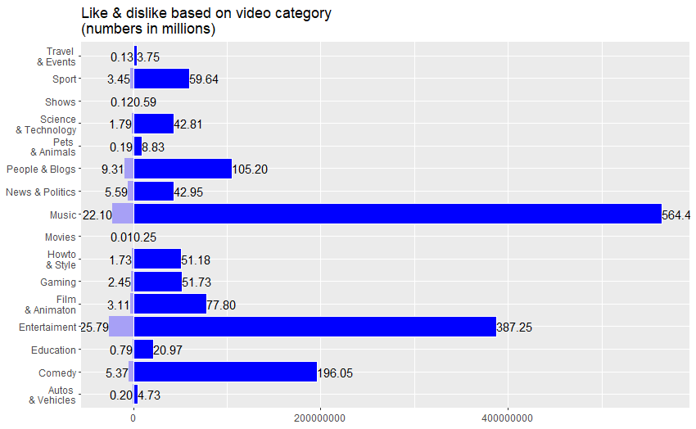
Bar Graph of like and dislike based on category

Slide 42
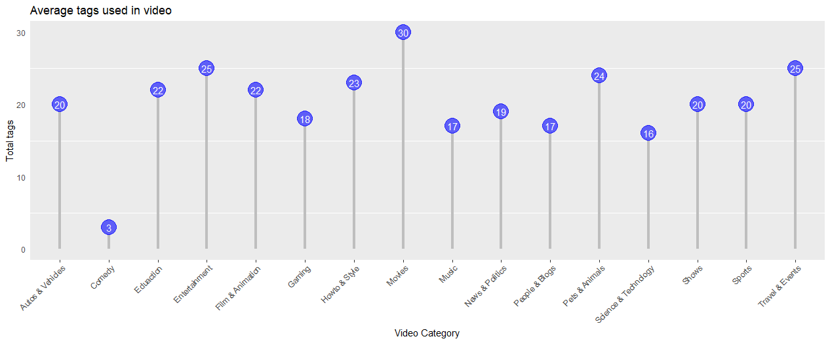
Lollipop Graph of Average tags used by videos based on category

Slide 43
CONCLUSION
This analysis is created for better understanding. It working fine in all situation and ready to get implemented in real world problems.
As perfection has no limit in the same way there are many future scopes where we try to implement more functionality to this analysis such as dynamic data like online data and do analysis etc.

Slide 44
BIBLIOGRAPHY
References
www.tutorialspoint.com
www.r-tutor.com
www.W3schools.in
www.r-graph-gallery.com
https://rpubs.com/CosHoef/159665

Slide 45
The End

